Slide 1
Lecture 7
Physics-based modelling of cell electrochemistry and ageing
Lecture 8
Battery thermal modelling
Yicun Huang, researcher
Department of Electrical Engineering
Chalmers University of Technology, Sweden
TRA 445
Advanced Battery Modelling and Control

Slide 2
Outline
Overview of physics-based modelling
Working principles of electrochemical cells
Survey of commercial/open-source tools
Challenges of physics-based models
Single particle model (SPM)
Solid-state diffusion
Ion exchange kinetics
Ageing
Reduced order modelling
Numerical methods
Single bucket model

Slide 3
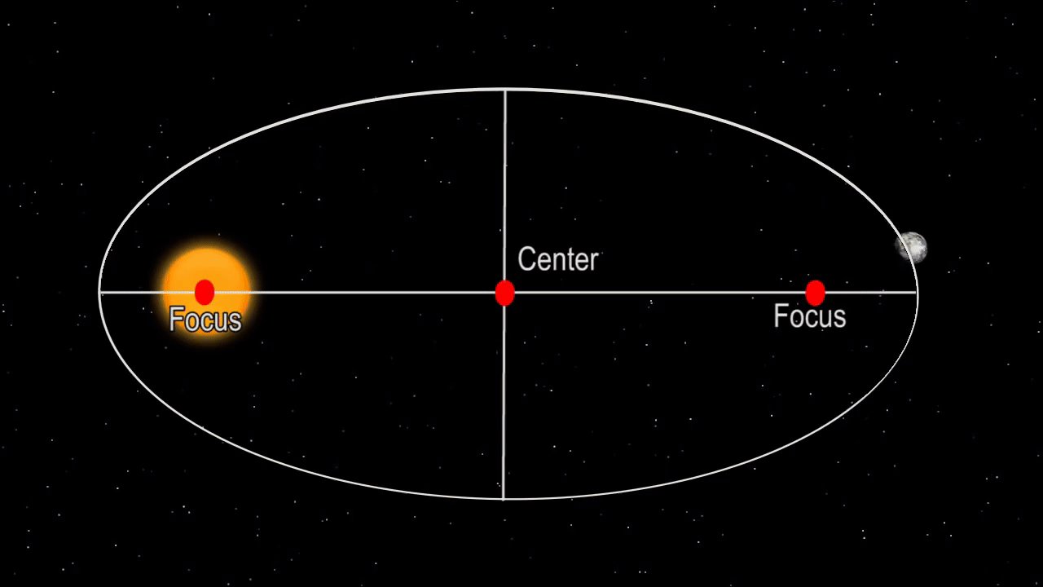

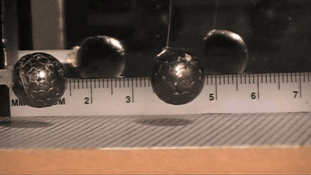
Lecture 5 v.s. lecture 7
Data-driven v.s. first-principle
Two approaches to discovering physical models
Data-driven
Kepler's law of planetary motion
Coulomb's law
Ohm's law
Ideal gas law
Butler-Volmer
First-principle
Fourier Diffusion
Principle of least action
Coupled ion-electron transfer (CIET) theory
3
Notes:
Transformer (for example, “ChatGPT”) They power a new generation of data-driven analytics. Not just a gimmick but a workhorse. However, this approach of discovering underlying input-output relations is not new:
Kepler dedicated 20 years of observation and discovered his laws of planetary motion. E.g. the square of orbital period is directly proportional to the cube of the longest radius R.

Slide 4
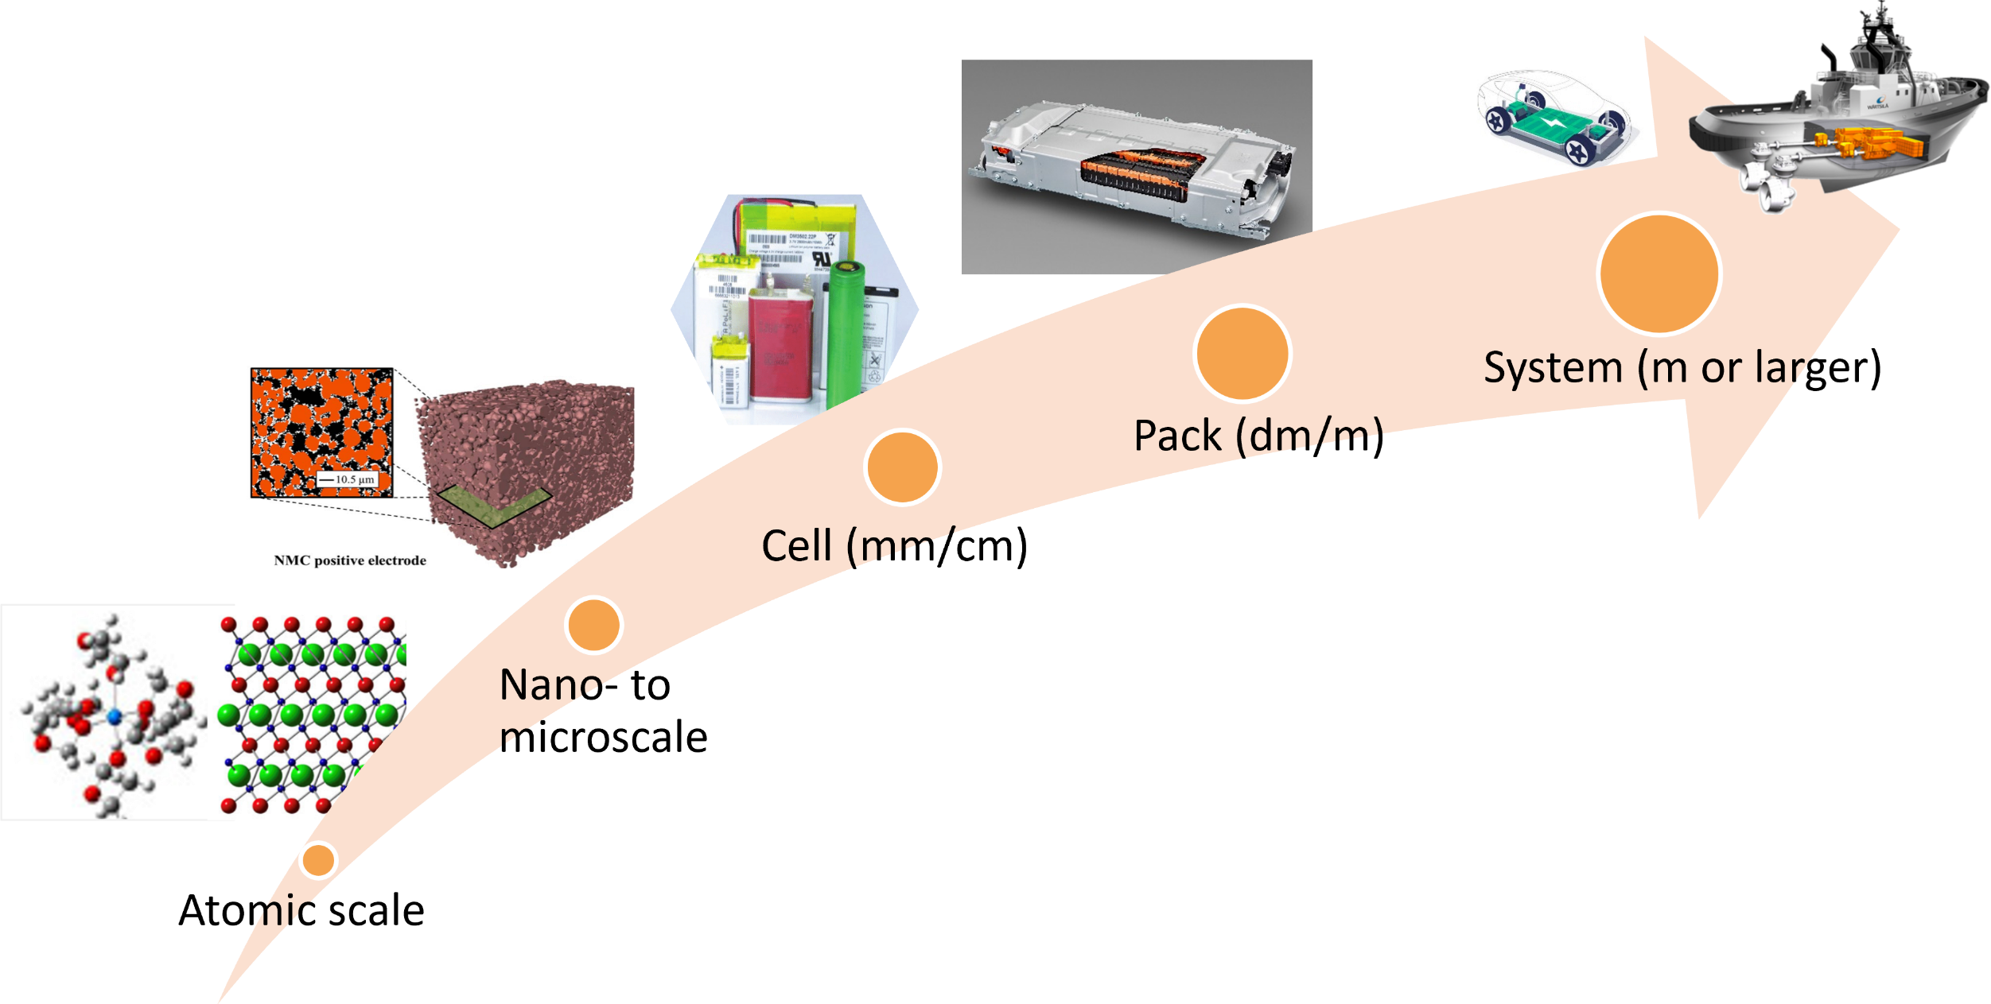
Physics-based modelling: broad area of research
Notes:
Categorise them from
Battery modeling is a broad area of research. We categorise them from atomic scale all the way to system scale modelling.

Slide 5
Physics-based modelling: broad area of research
Materials Science
SEI growth
Li plating
Mechanical aging
Efficiency
Safety
User habits
V2X
Interaction with environment
Cell balancing
Thermal gradient
Cooling system
Pack modelling
Cell modelling
Cell control
SoX estimation
Capacity fade
Resistance rise
EIS
Electrical potential
Diffusion
Charge transfer
Automatic Control
Industrial focus
Notes:
In materials science, we care about …
At automatic control, we are dealing with …
In industry, …
They all play a crucial role in optimizing battery performance, improving safety, and extending the lifespan of batteries across applications like electric vehicles and energy storage systems.

Slide 6
Where does physics-based cell modelling fit into BMS?
ECM
ECM + thermal
Physics-based
v_{max}
STAY HERE!
STAY HERE!
STAY HERE!
voltage
voltage
voltage
Stage I graphite
v_{min}
T_{max}
i_{min}
current
i_{max}
current
T_{min}
temperature
current density
core temperature
anode potential
surface concentration

Slide 7
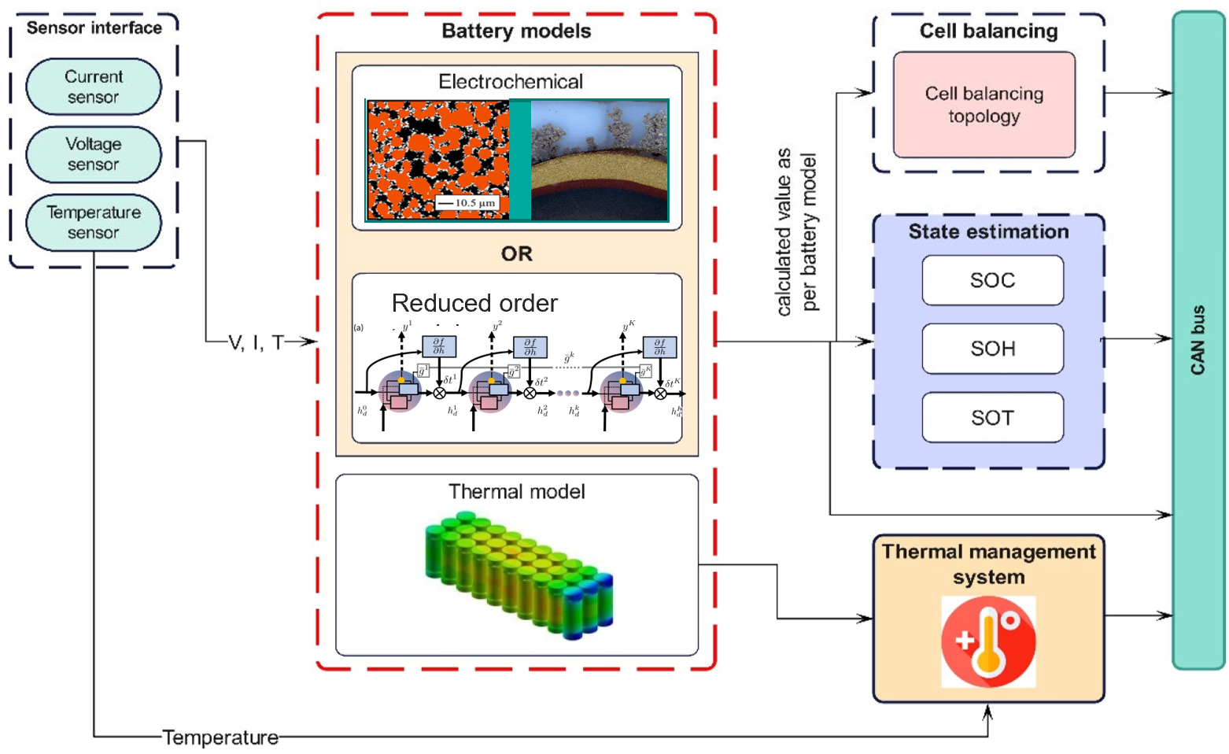
Where does physics-based cell modelling fit into BMS?
Notes:
Battery Models Integration:
Physics-based models, such as detailed electrochemical and thermal models, capture internal battery dynamics for accurate predictions.
Reduced-order models simplify these complex models to achieve real-time performance.
State Estimation (SOC, SOH, SOT):
Physics-based models help estimate crucial battery states:
State of Charge (SOC): Energy remaining in the battery.
State of Health (SOH): Battery capacity degradation.
State of Temperature (SOT): Temperature prediction to maintain safe operating conditions.
Thermal Model for Safety and Efficiency:
Physics-based thermal models enable precise heat management for avoiding overheating and thermal runaway.
Supports the thermal management system to maintain optimal temperature ranges.
Cell Balancing:
Accurate modeling helps design balancing algorithms by predicting individual cell behaviors and thermal gradients.
Sensor Interface and Real-Time Monitoring:
Measured parameters (voltage, current, and temperature) are compared with model predictions to correct errors and provide robust state estimation.
Control and Communication:
Model-based insights are communicated via the CAN bus for BMS functions, ensuring safer battery operations.

Slide 8
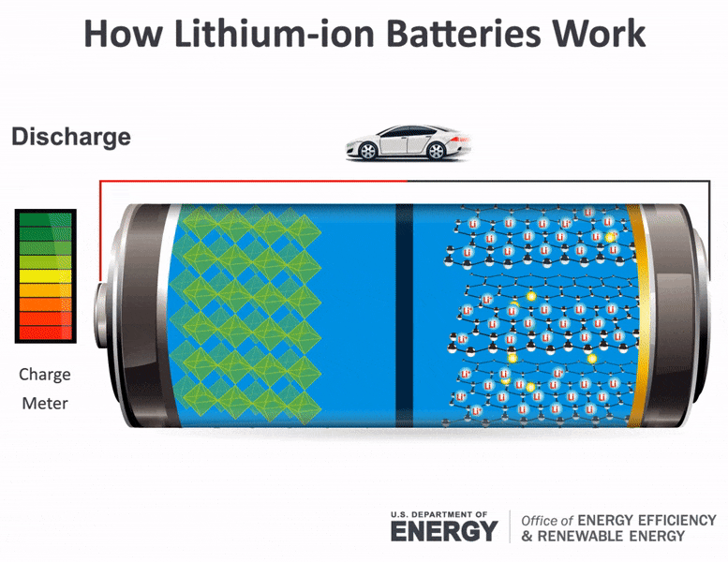

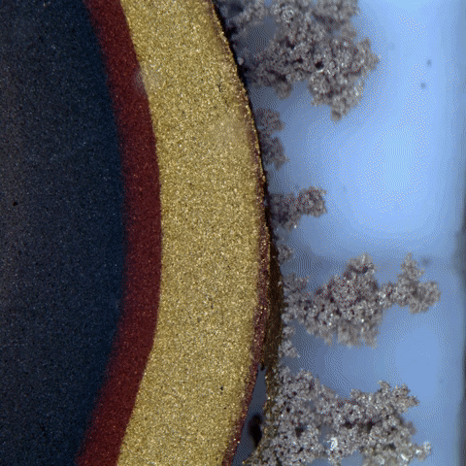
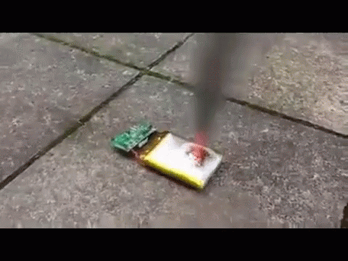
Battery models: Multiphysics
Multiphysics are commonly dynamically coupled inside a battery cell, maybe in different timescales.
Electrochemical
Electrical
Lecture 7
Aging
Mechanical & Thermal
Lecture 8
Harris et al. (2010). Chem. Phys Letter.
[Zou, C., Manzie, C., & Nešić, D. IEEE Transactions on Control Systems Technology, 2016]
Notes:
Battery systems are multiphysics in nature.
Electrical Behavior: This involves the current-voltage relationship, impedance characterization. Well-understood and fundamental to the delivery of power and energy storage.
Electrochemical: Chemical reactions and ion transport within the battery. （Chromogenic --》 phase change)
Aging: Long-term degradation and lifespan considerations.

Slide 9
Outline
Overview of physics-based modelling
Working principles of electrochemical cells
Challenges of physics-based models
Single particle model (SPM)
Solid-state diffusion
Ion exchange kinetics
Reduced order modelling
Numerical methods
Single bucket model

Slide 10

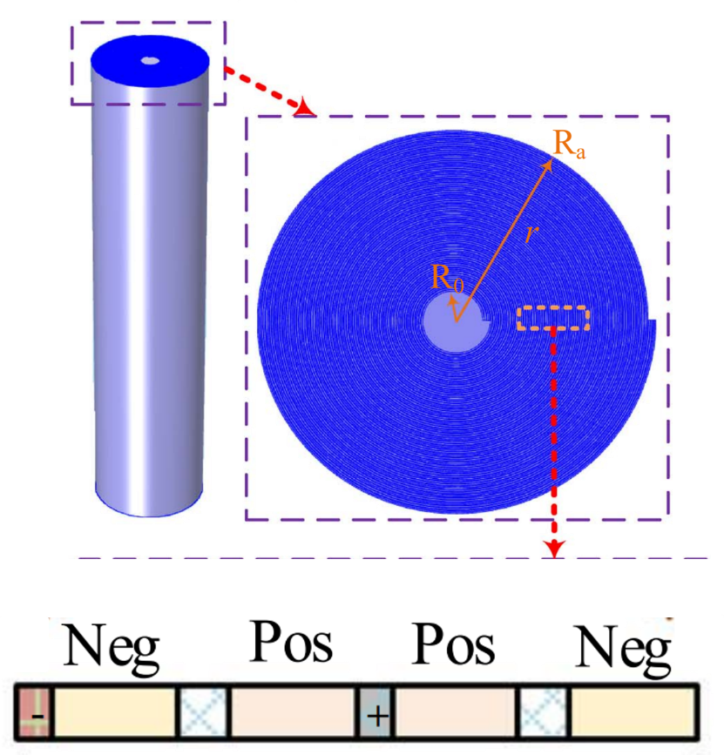
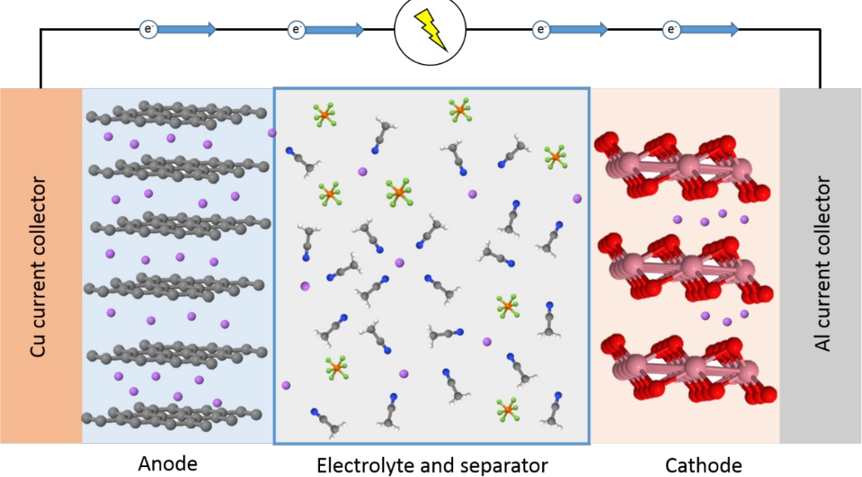
Working principles of electrochemical cells: materials
cylindrical
Notes:
Terminalology:
Electrical engineering: Neg sep Pos
Materials science: Anode sep Cathode
They always have a fight

Slide 11
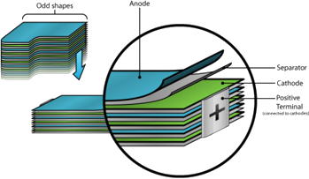

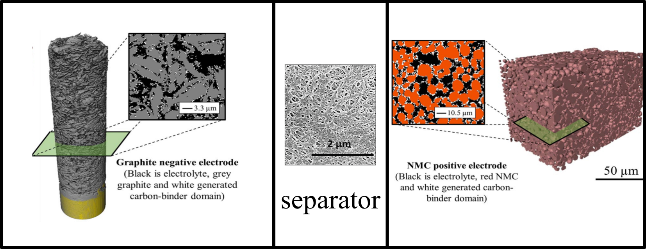
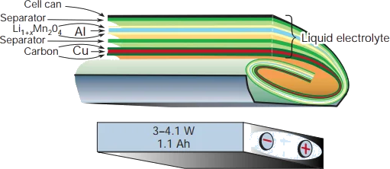
Working principles of electrochemical cells: materials
pouch
anode
cathode
prismatic
Notes:
Terminalology:
Electrical engineering: Neg sep Pos
Materials science: Anode sep Cathode
They always have a fight

Slide 12
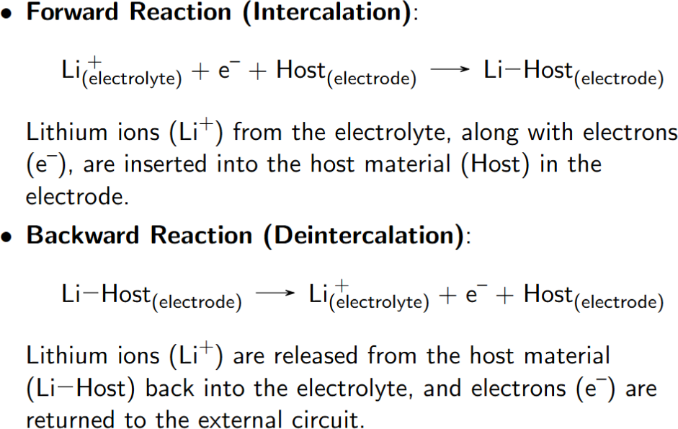
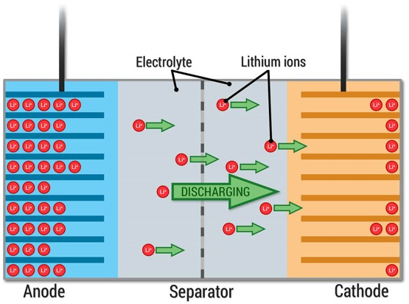
Working principles of electrochemical cells:

Slide 13
Outline
Overview of physics-based modelling
Working principles of electrochemical cells
Survey of commercial/open-source tools
Challenges of physics-based models
Single particle model (SPM)
Solid-state diffusion
Ion exchange kinetics
Reduced order modelling
Numerical methods
Single bucket model

Slide 14

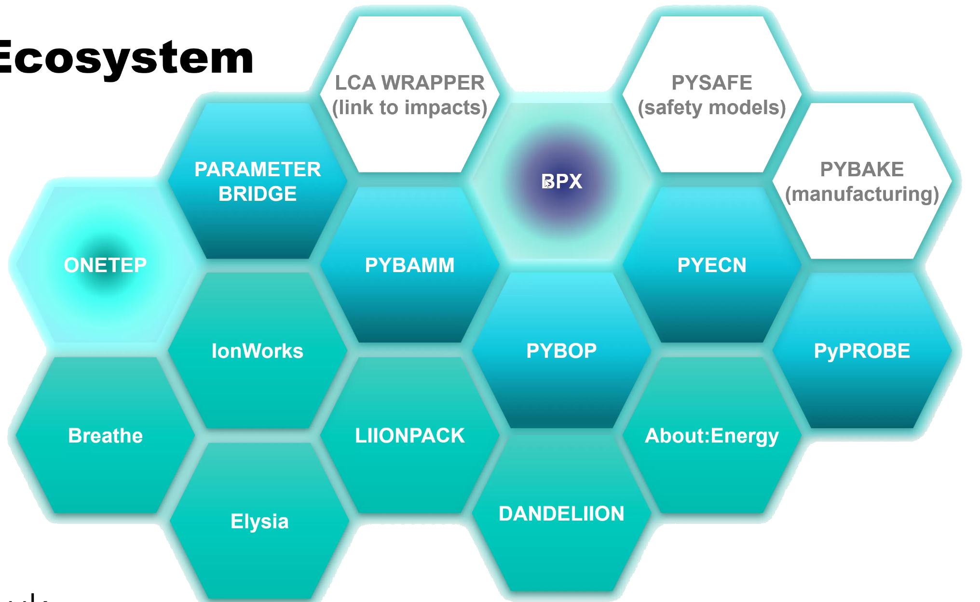


Physics-based modelling packages: survey
20+ packages
Propiriatary
Open-source
Economics
languages
Developing team
Eco-system

Slide 15

Challenge 1: parameterisation
Accurate parameterization ensures that the model predictions align with experimental data
E.g., an incorrect diffusion coefficient would lead to errors in predicting lithium concentration profiles
However, it is difficult to capture real-world variability
temperature-dependent parameters
ageing-related parameters
parameter variation due to assumptions
“With four parameters I can fit an elephant.”
- John von Neumann

Slide 16
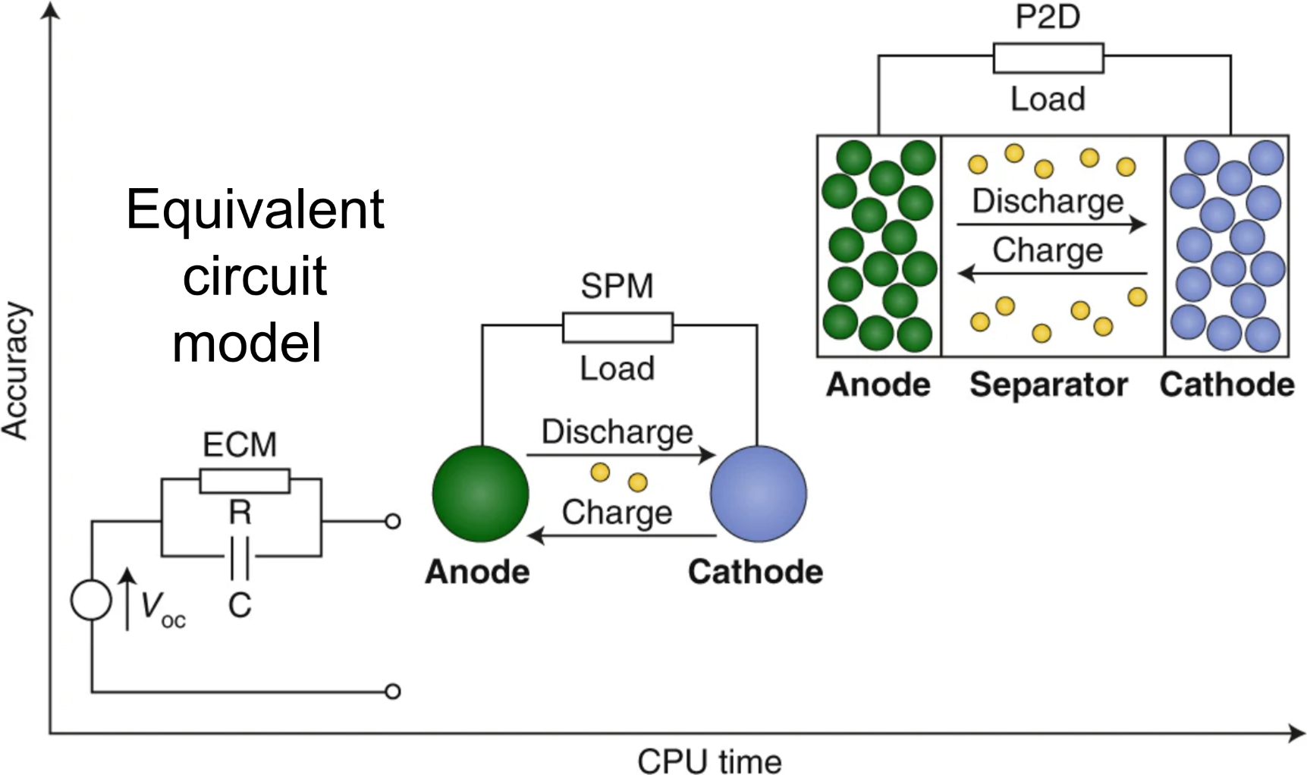
Challenge 2: computational complexity
In terms of model order

Slide 17
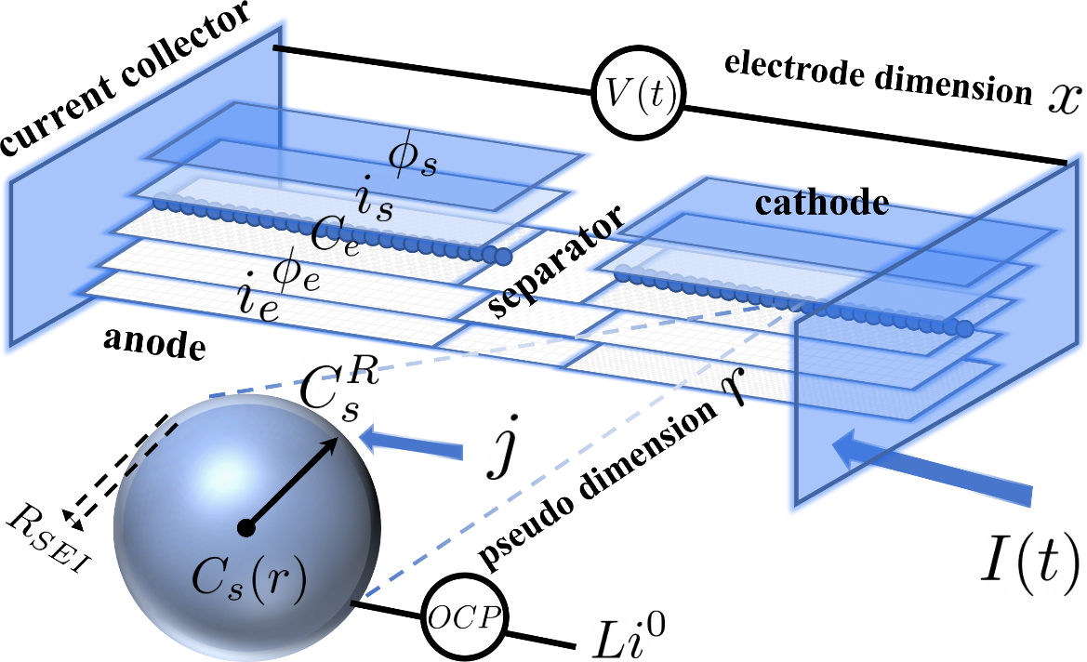
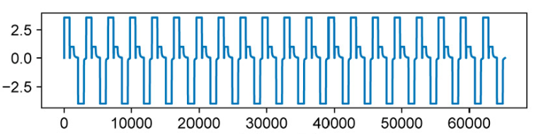
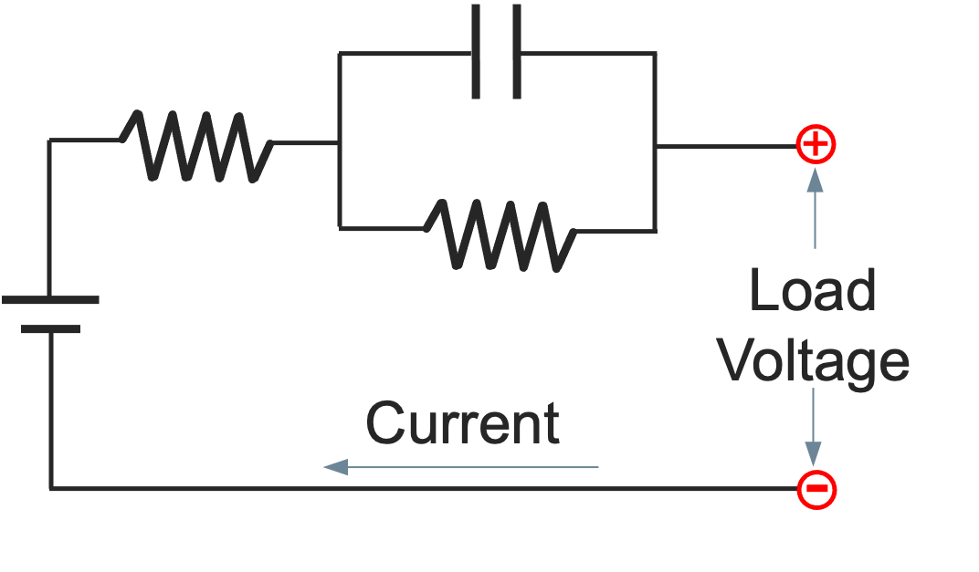
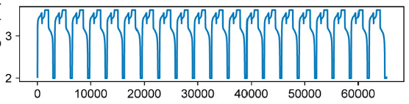
Challenge 2: computational complexity
In terms of number of parameters
Grey-Box Model
(e.g., n^{th} order RC model)
White-Box Model
(e.g., P2D model)
Black-Box Model
(e.g., ANN model)
Input
Output
number of parameters
Notes:
In general, there are three types of battery models.
Battery dynamics take place in different length-scales and timescales.
These dynamics are fully coupled, and it can be challenging to isolate the individual physics.
These models have very different mathematical structures, corresponding to different fidelity of modelling and application scenarios. However, none of them can individually solve all the BMS problems.

Slide 18
Outline
Overview of physics-based modelling
Working principles of electrochemical cells
Survey of commercial/open-source tools
Challenges of physics-based models
Single particle model (SPM)
Solid-state diffusion
Ion exchange kinetics
Ageing
Reduced order modelling
Numerical methods
Single bucket model

Slide 19
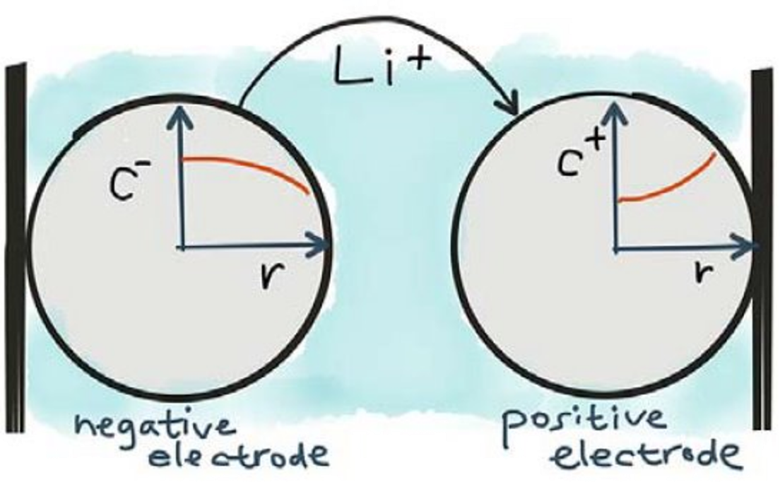
Single particle model
Two key physics
Solid phase diffusion
Ion exchange at the electrolyte-particle interface
Key differences v.s. ECM
Describe by PDEs with BCs and algebraic equations
Fixed parameters with no SOC dependence
Consider the two electrodes separately
OCP as opposed to OCV

Slide 20
Single particle model
Key assumptions (in addition to P2D assumptions)
Single spherical particle representation approximating the porous structure of the electrode material.
Transport of lithium ion in the electrolyte is fast compared to solid-phase transport, thus neglecting electrolyte diffusion and migration.
Uniform reaction rate, simplifying the interaction between the particle and the electrolyte (decoupled).

Slide 21
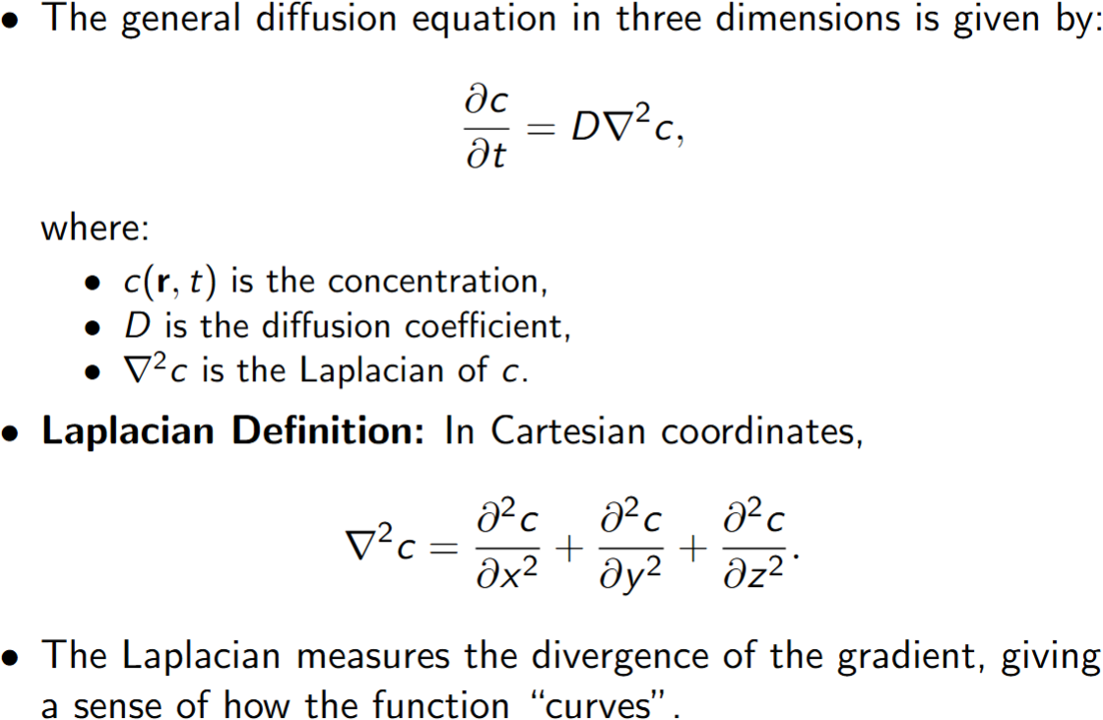

Single particle model: solid phase diffusion

Slide 22
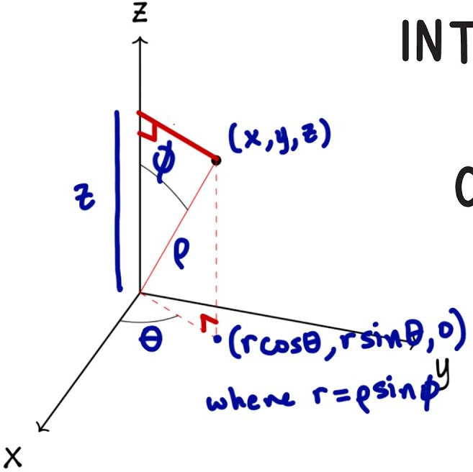
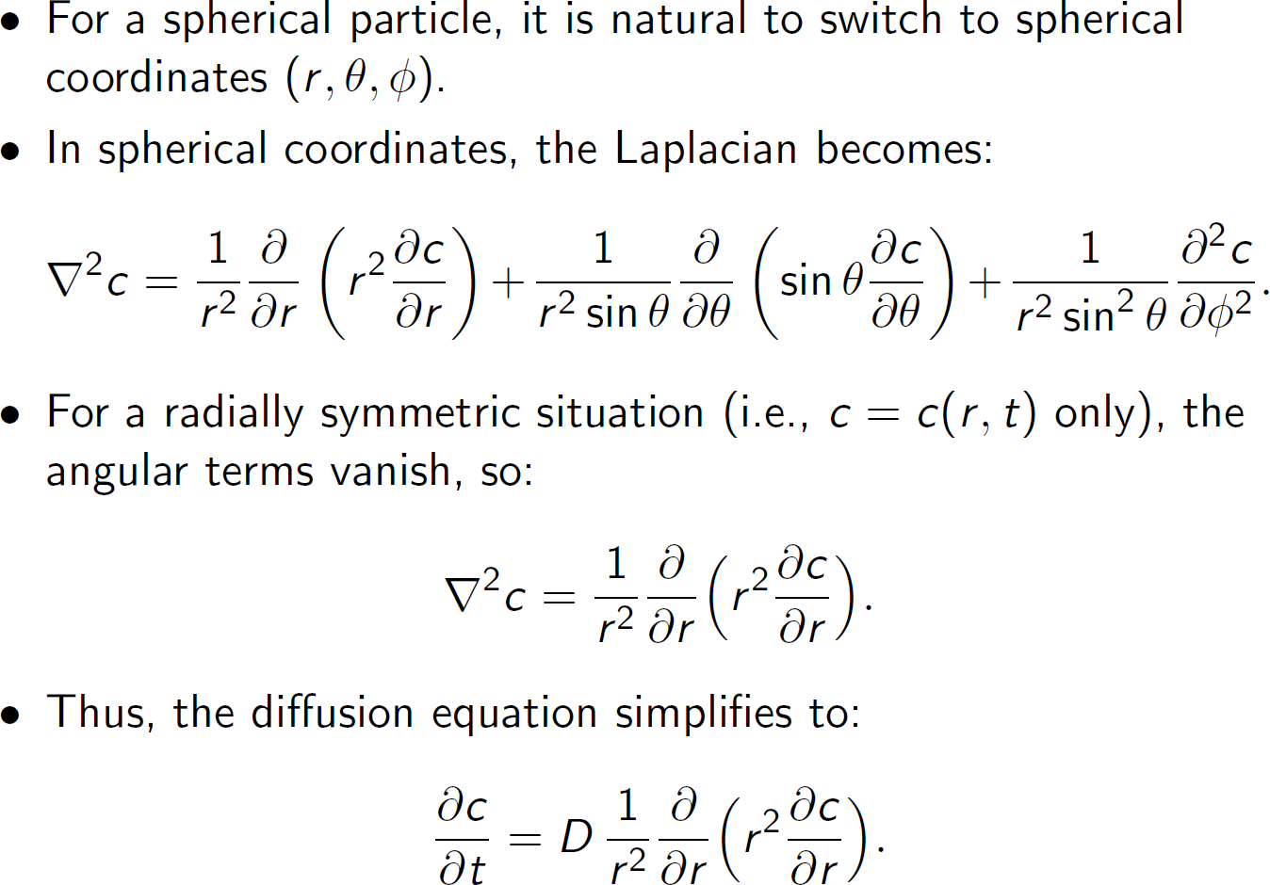
Single particle model: solid phase diffusion
3D

Slide 23
Single particle model: solid phase diffusion
1D
r = R
r = 0
r

Slide 24
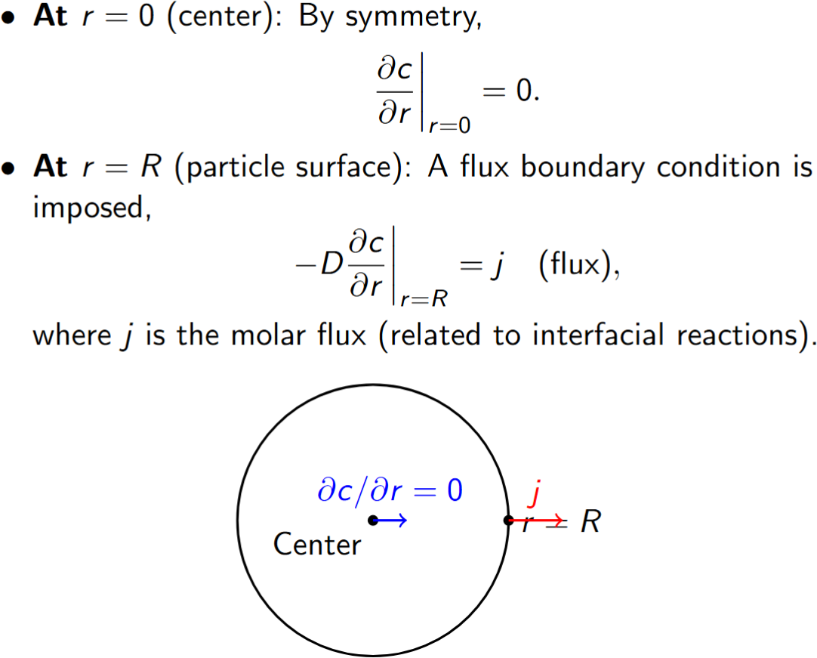
Single particle model: solid phase diffusion
1D
r = R
r = 0
r

Slide 25
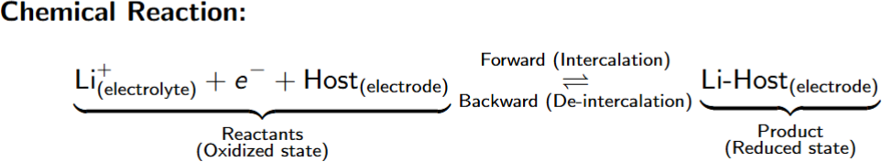
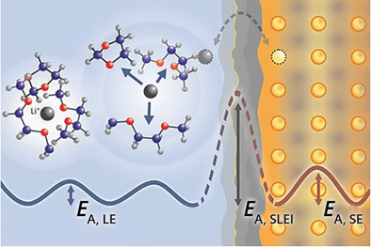
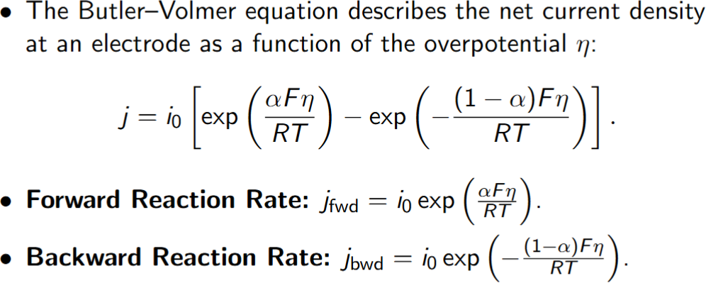
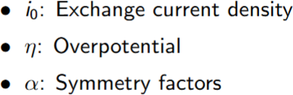
Single particle model: Butler-Volmer kinetics

Slide 26
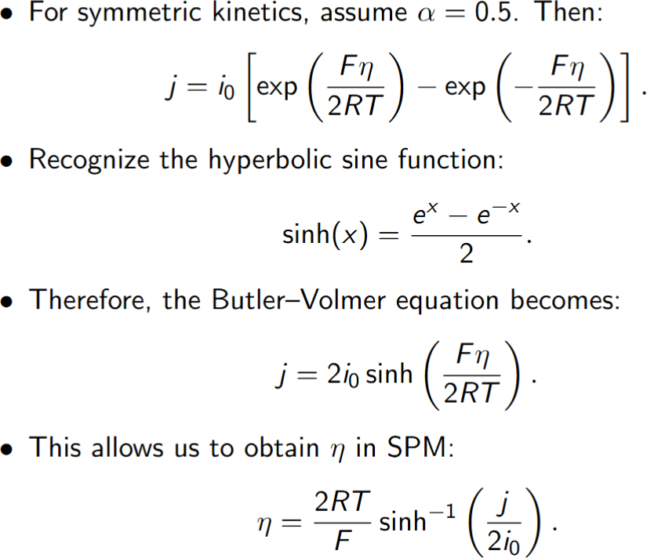
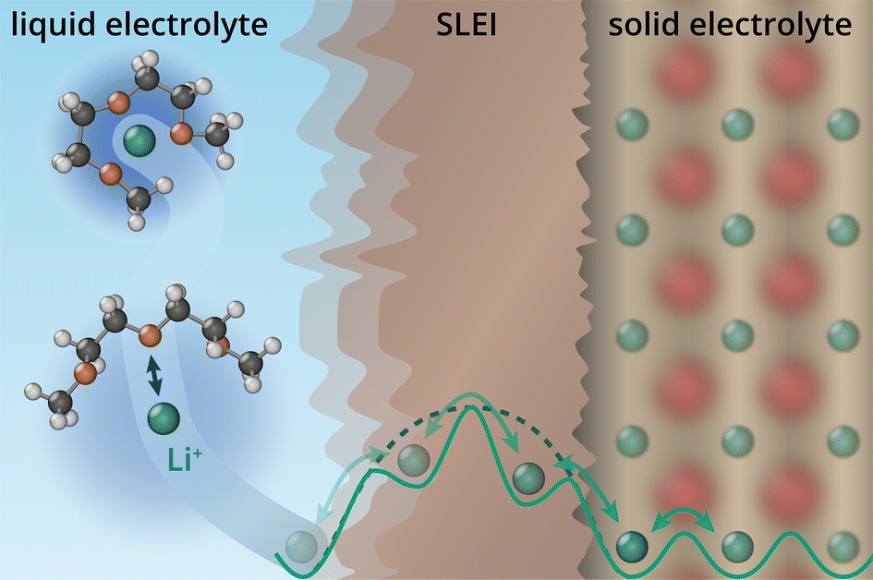
Single particle model: Symmetric Butler-Volmer kinetics

Slide 27
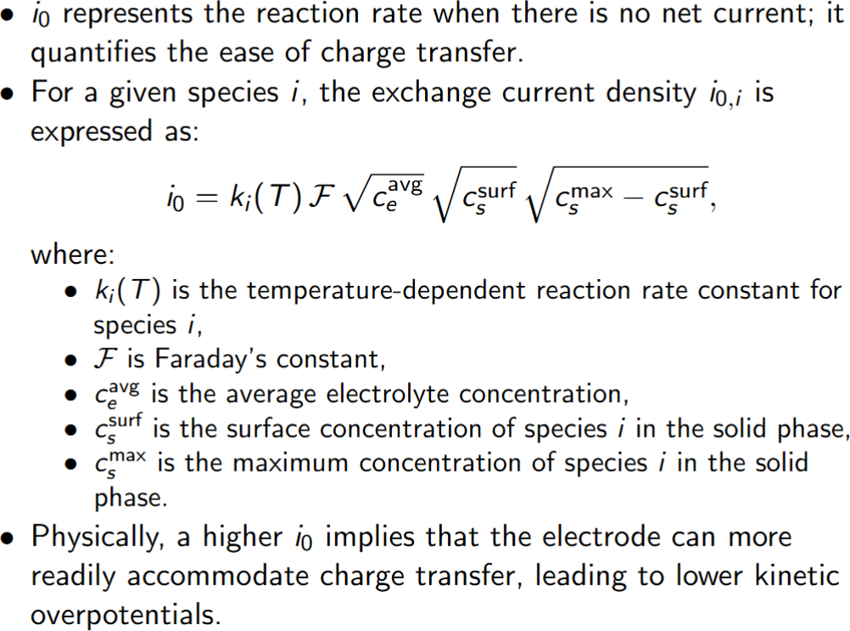
Single particle model: Exchange current density

Slide 28
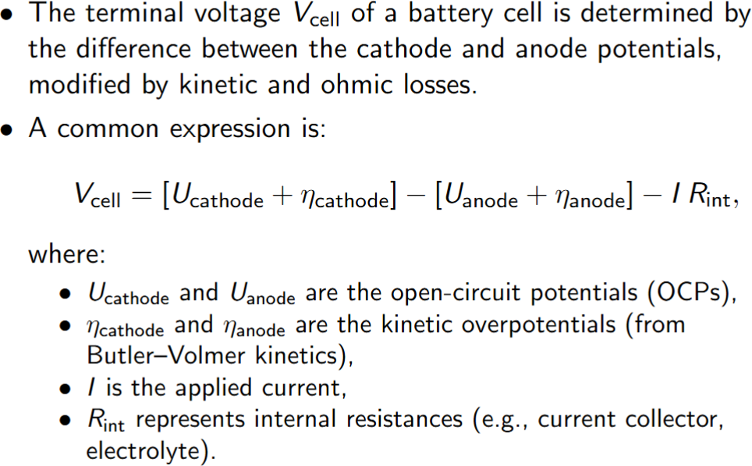
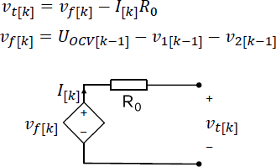
Single particle model: Voltage calculation
It is calculated from surface concentration,
not SOC.
Sounds familiar?

Slide 29
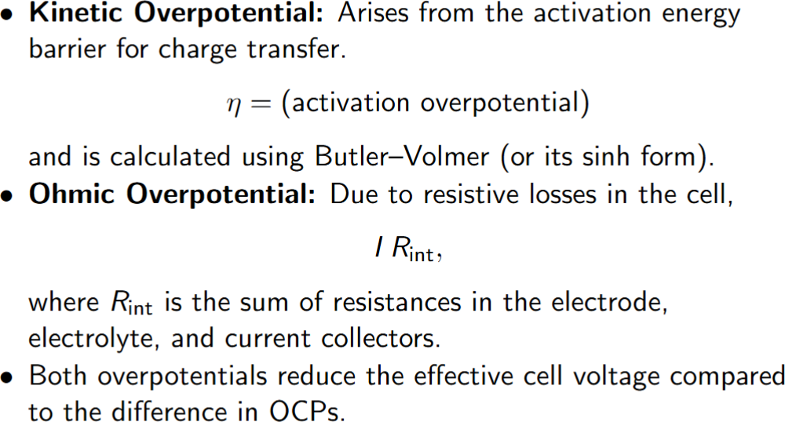
Single particle model: Voltage calculation
What is the equivalent of overpotential in the ECM model from lecture 6?

Slide 30
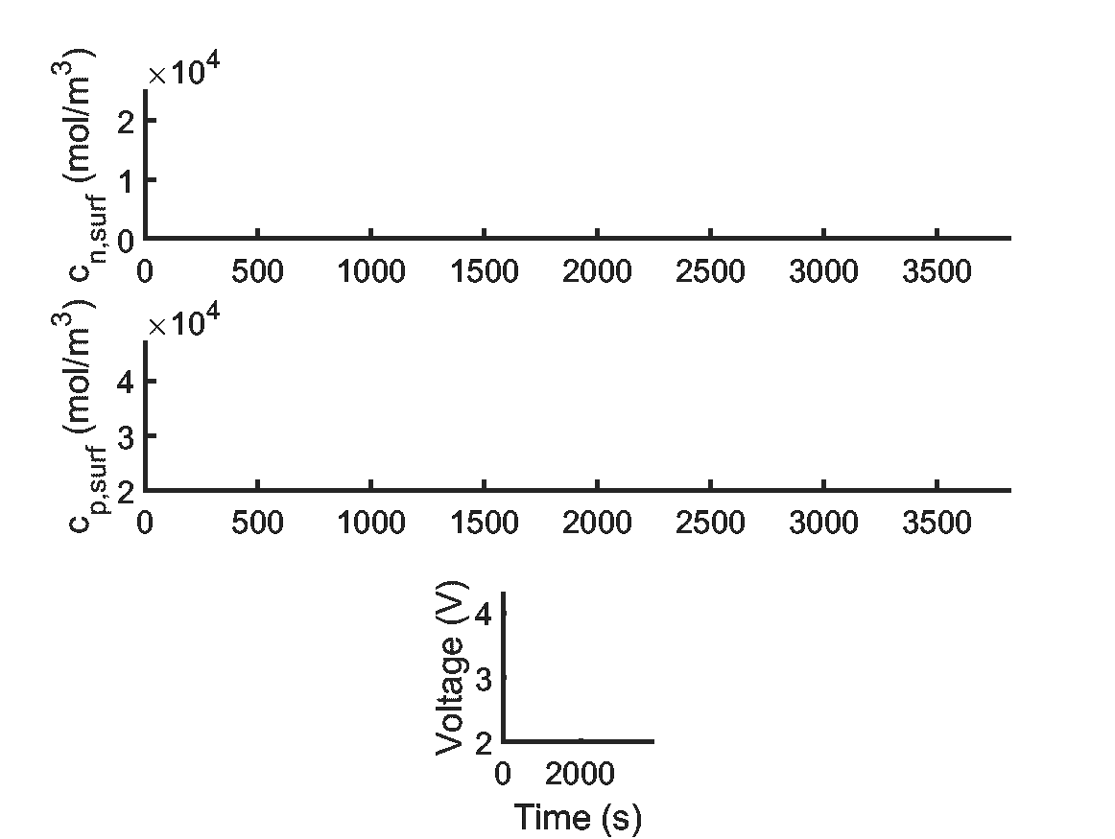
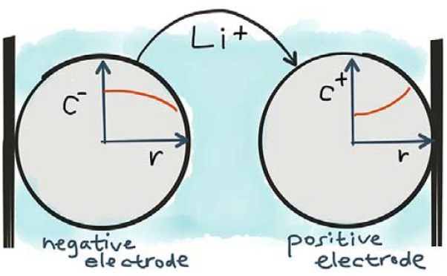
Single particle model: simulation
Charge
Discharge

Slide 31
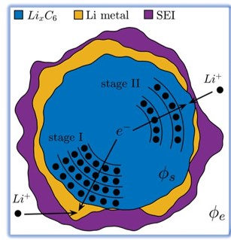
Single particle model: Ageing
Loss of lithium inventory (LLI)

Slide 32
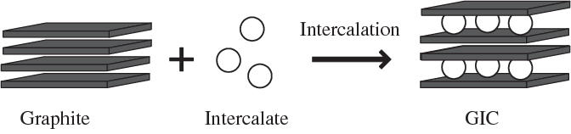
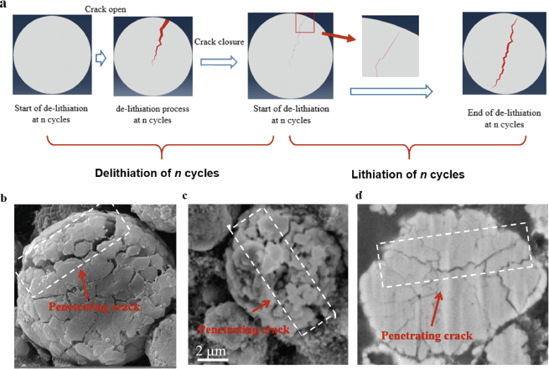
Single particle model: Ageing
pressure
strain
Loss of active material (LAM)

Slide 33
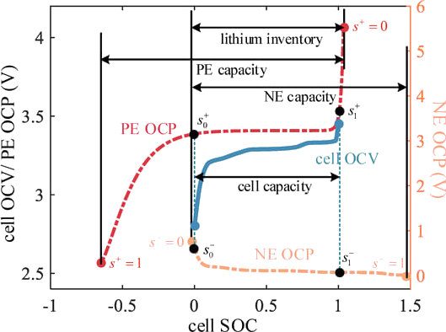
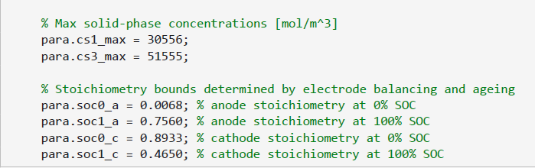
Single particle model: Ageing
Four important ageing-related parameters:

Slide 34
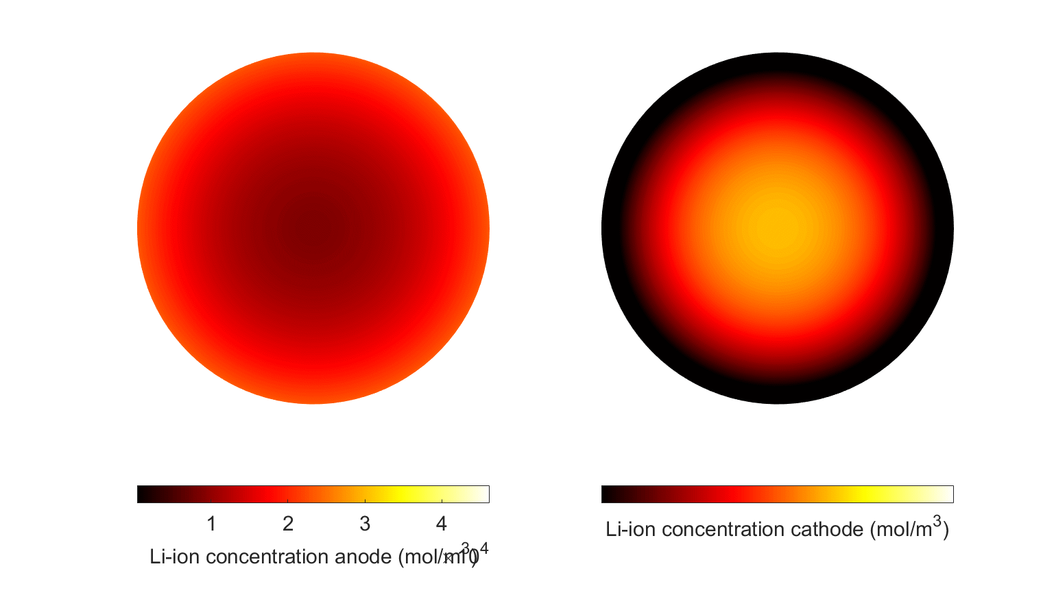
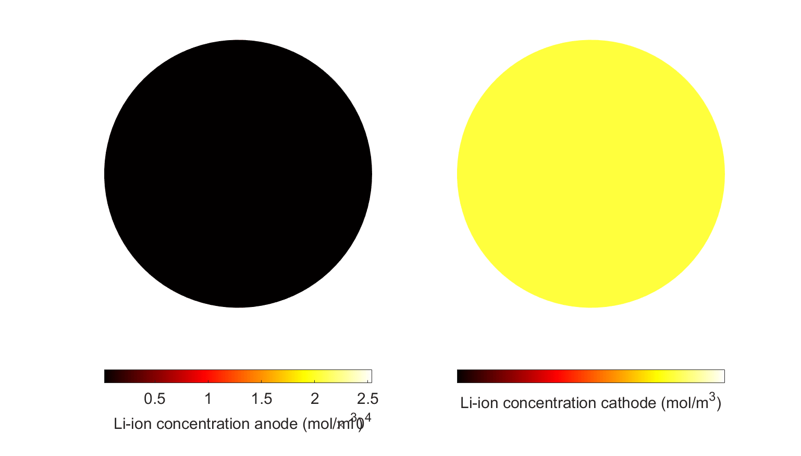
Lecture 7 Recap
SPM v.s. ECM
Individual electrode
Li-ion concentration
Surface concentration
Ageing
Buler-volmer kinetics
SOC-independent parameters

Slide 35
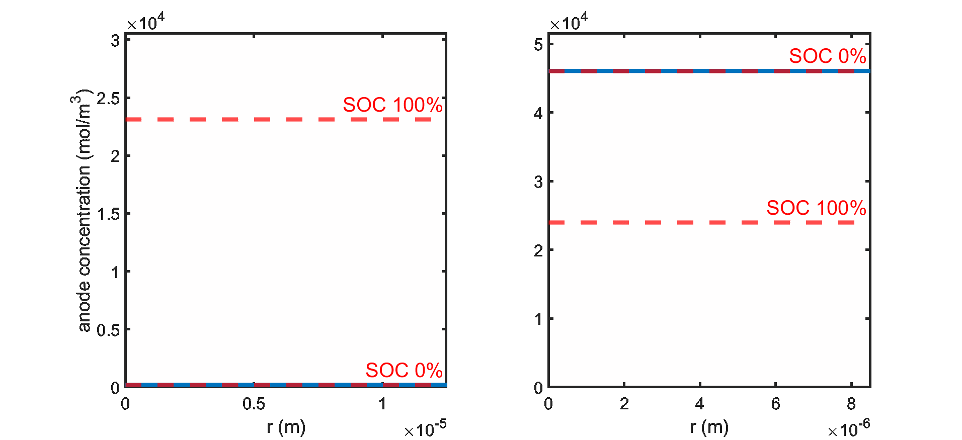
Lecture 7 Recap
Four stoichiometry parameters
Physical meaning
Why does c_s(r=R) often go beyond the limits?
2C charge

Slide 36
Lecture 7 Recap
Four stoichiometry parameters
Physical meaning
Why does c_s(r=R) often go beyond the limits?
4C charge
Concentration gradient
Overpotential
Relaxation

Slide 37
Lecture 7 Recap
Four stoichiometry parameters
Physical meaning
Why does c_s(r=R) often go beyond the limits?
4C charge
Concentration gradient
Overpotential
Relaxation

Slide 38
Outline
Overview of physics-based modelling
Working principles of electrochemical cells
Survey of commercial/open-source tools
Challenges of physics-based models
Single particle model (SPM)
Solid-state diffusion
Ion exchange kinetics
Ageing
Reduced order modelling
Numerical methods
Single bucket model

Slide 39
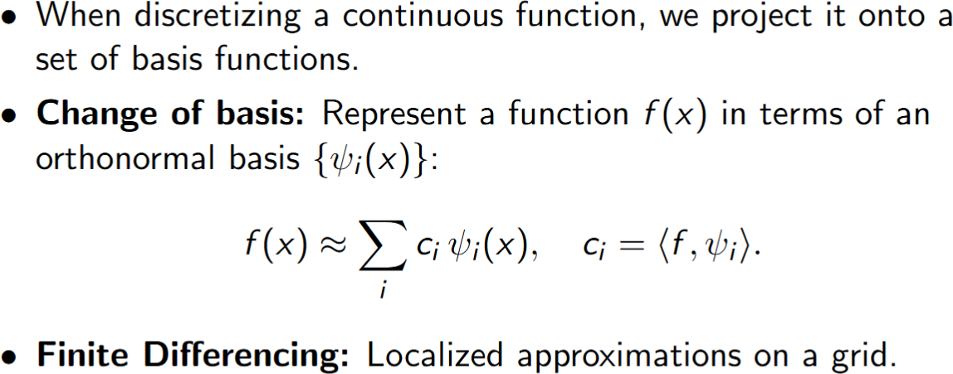
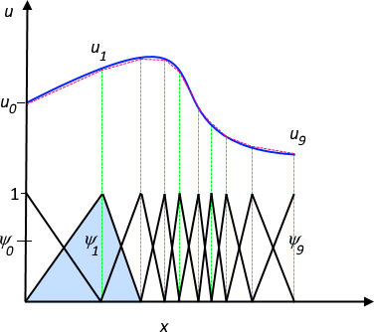
Numerical methods
Example: hat basis function and adaptive meshing

Slide 40
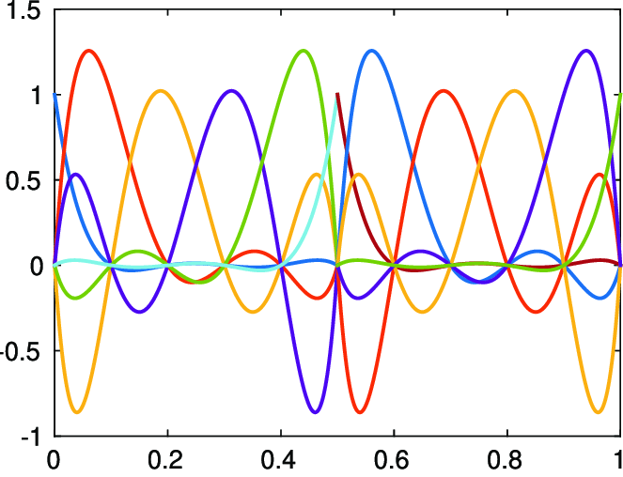
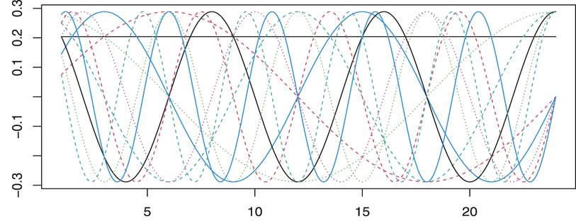
Numerical methods
E.g. Lagrangian basis functions
Spectral method
Finite element method (FEM)
Finite volume method (FVM)
…
E.g. Fourier basis functions

Slide 41
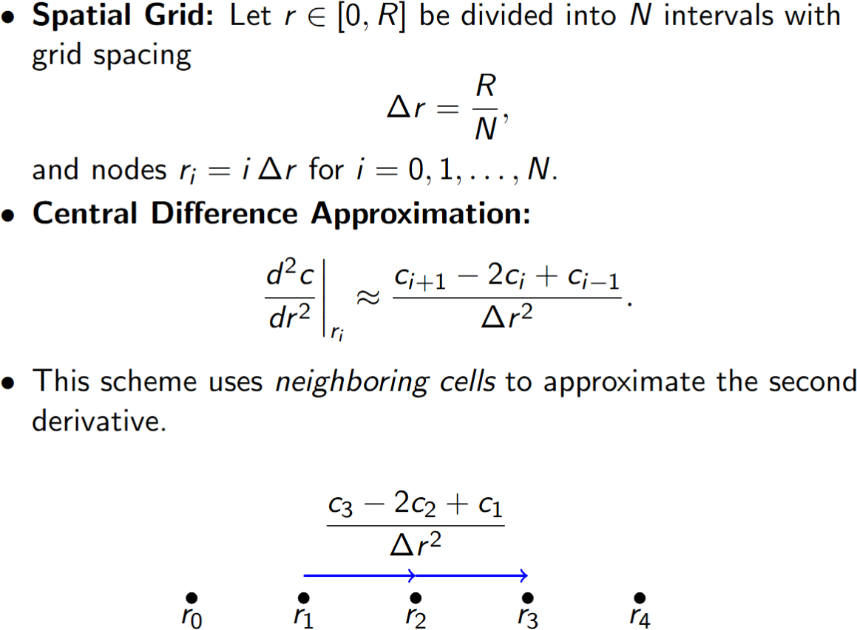


Numerical methods: Finite difference method
Some people regard these methods as reduced order modelling (ROM). Why?
c
c(r,t)
r

Slide 42




Reduced order modelling (ROM)
two-state single bucket model
Li+
anode
cathode

Slide 43

Reduced order modellin: single bucket model

Slide 44

Reduced order modellin: single bucket model
Time Evolution of the Average Concentration

Slide 45

Reduced order modellin: single bucket model
Evaluating the Integral and Using Boundary Conditions

Slide 46
Outline
Temperature effects
Thermal modelling
Thermal modelling: numerical methods
Lumped thermal model
Thermal management

Slide 47

Temperature Effects
What determines the capacity?
Q = Q(I, T)
Temperature–dependent parameters
Physical meaning
The greater the temperature of the system, the greater the kinetic energy of the atoms

Slide 48


Temperature Effects
What determines the capacity?
Q = Q(I, T)
Temperature–dependent parameters
Physical meaning
The greater the temperature of the system, the greater the kinetic energy of the atoms
Arrhenius equation
The frequency of successful jumps

Slide 49




Temperature Effects
What determines the capacity?
Q = Q(I, T)
Temperature–dependent parameters
Physical meaning
The greater the temperature of the system, the greater the kinetic energy of the atoms
Arrhenius equation
The frequency of successful jumps
where $E_{a}$ is an activation energy and R is the gas constant. Whereas $D_{s,ref}$ and $T_{ref}$ are the reference diffusion coefficient and ambient temperature.

Slide 50
Outline
Temperature effects
Thermal modelling
Thermal modelling: numerical methods
Lumped thermal model
Thermal management

Slide 51

Why Include Temperature?
Safety and Performance: Excessive heating can degrade battery materials, while low temperatures can significantly reduce power capability.
Thermal Runaway Concerns: In extreme cases, localized heating can lead to thermal runaway if not managed.

Slide 52

Thermal modelling
Spatially varying temperature
E.g. core temperature
Thermal gradient
Spatially varying parameters
Temperature-dependence
Pouch cells with varying tab locations.

Slide 53

Thermal modelling
Spatially varying temperature
E.g. core temperature
Thermal gradient
Spatially varying parameters
Temperature-dependence
Pouch cells with varying
tab locations.
Y. Zheng, et al. (2023). Thermal state monitoring of lithium-ion batteries: Progress, challenges, and opportunities. Progress in Energy and Combustion Science

Slide 54




Thermal modelling
Spatially varying temperature
E.g. core temperature
Thermal gradient
Spatially varying parameters
Temperature-dependence
In-plane and through-plane
E.g. $D_{s,ref}(x,y,z)$

Slide 55

Thermal modelling: numerical methods
G. Peprah, Y. Huang, T. Wik, F. Altaf & C. Zou. (In revision). Thermal Modelling of Battery Cells for Optimal Tab and Surface Cooling Control. IEEE TCST.

Slide 56



Thermal modelling: numerical methods
Particular Solution Decomposition
Original PDE
Spectral-Galerkin
ODEs
Time
Integration
G. Peprah, Y. Huang, T. Wik, F. Altaf & C. Zou. (In revision). Thermal Modelling of Battery Cells for Optimal Tab and Surface Cooling Control. IEEE TCST.

Slide 57



Thermal modelling: mesh-free methods
Physics-informed neural networks (PINNs)
Grid-free and solver-free
Physical constraints determined by PDE
Teodorescu, et al. (2022). Smart battery technology for lifetime improvement. Batteries.

Slide 58
Outline
Temperature effects
Thermal modelling
Thermal modelling: numerical methods
Lumped thermal model
Thermal management

Slide 59


Thermal modelling: lumped thermal model
Assuming temperature gradient is small
we can write a simple energy balance in the form:
where,

Slide 60

Thermal modelling: lumped thermal model
Assuming temperature gradient is small
we can write a simple energy balance in the form:
The total heat generation rate per unit volume, can be decomposed into several contributions:

Slide 61

Thermal modelling: lumped thermal model
Reversible (Entropic) Heat
Where,
the terms in the bracket measure how temperature shifts the equilibrium voltage of each half‐reaction, which in turn dictates how much entropic heat is absorbed or released when the cell is operated at different temperatures.
L is the total thickness of the electrode sandwitch

Slide 62

Thermal modelling: lumped thermal model

Slide 63

Thermal modelling: lumped thermal model
Convective Cooling Term
Newton (convective) cooling boundary condition

Slide 64
Outline
Temperature effects
Thermal modelling
Thermal modelling: numerical methods
Lumped thermal model
Thermal management

Slide 65






Thermal management
Health and lifetime
Thermal safety
Temperature
charging
Energy efficiency
Dynamic performance

Slide 66




Thermal management
Phase change materials
Air cooling
Liquid cooling
Heat pipes
Advantages
Low cost
Simplicity
Disadvantages
Poor thermal performance
Moving parts (noise)
Good thermal performance
High efficiency
Potential leakage
Increased weight
Compact
High efficiency
Costly
Small contact area
Uniform temperature distribution
No moving parts
Potential leakage
Increased weight

Slide 67


Thermal management
Cooling plate designs
Simulations

Slide 68

Thermal management
Cooling plate arrangements

Slide 69


Thermal management
Commercial cooling channel designs
Hyundai Group's Electric-Global Modular Platform (E-GMP)

